Slide 1
Wired Equivalent Privacy (WEP)
College of Information Technology
Department of Software Engineering
Presented By:
Hanan Salih Shahad Abdulbari Omaima Muyeaser
Raheed Fadi Khaled Ahmed
Supervised By:
Dr. Omar Sami

Slide 2
Introduction
Wired Equivalent Privacy (WEP): security protocol for wireless networks that provides data confidentiality comparable to wired network. It provides security through the use of an encryption key.
It’s a weak and old protocol, we will talk later about the newest as well.

Slide 3
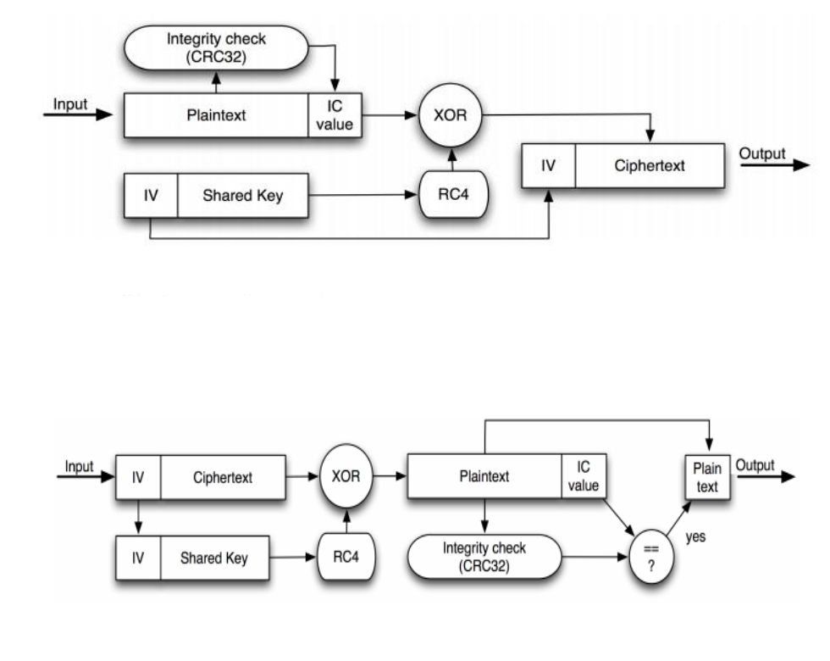
Encryption:
Decryption:

Slide 4
What is WEP
There are many types of the WEP (i.e. WEP-64, WEP-128, WEP-152 and WEP-256). These types use a 24-bit initialization vector (IV) with the rest being key bits resulting in a total length of each type.
The WEP will generate a per-packet key by the shared WEP key with a randomly generated IV then use the Revise Cypher 4 (RC4) algorithm for encryption and Cycle Redundancy Check (CRC-32) checksum for data integrity. The receiver uses the IV with the shared WEP key to decrypt the data.
Notes:
WEP أنواع
تنذكر بس كتعداد وخله شرح طول المفتاح ودمجه مع منهو وحجم البتات تبع اليوزر هذه كلها تكون شرح عام بدون ارقام تفصيلية

Slide 5
IV, RC4 and CRC-32
Initialization Vector (IV): is a, fixed-size sequence of bits used to enhance security. In WEP, the IV is a 24-bit value. randomly generated by True Random Number Generation (TRNG), Pseudo-Random Number Generation (PRNG) or Quasi-Random Number Generation (QRNG)
Rivest Cipher 4 (RC4): encryption algorithm, encrypts one bit/byte at a time used in WEP.
Cyclic Redundancy Check (CRC-32): checksum algorithm used to detect errors in data during transmission or storage.

Slide 6
In General
Those Provides a basic level of security for wireless networks. But use weak encryption algorithm (RC4). Small (IV) size (24-bit) may lead to key reuse. Attackable by (IV) collision and key cracking. Lacks for integrity exposed to packet injection and modification.
Although WEP was a stepping stone in wireless security, it has been largely consumed due to its weaknesses. Modern alternatives like Wi-Fi Protected Access (WPA1), (WPA2) and (WPA3) provide much stronger security mechanisms for wireless communication.
Notes:
هذا هو سلايد النتقالي من القديم الى الحديث
بما انه حط لك اسم عام للبروتوكول فيقدر يحاججك بان تشرح من اقدم اشي الى احدث اشي بما انه الجديدات اهم اشي فانت تختصر كل الكلام عن القديمات وتتوسع بالجديدات

Slide 7
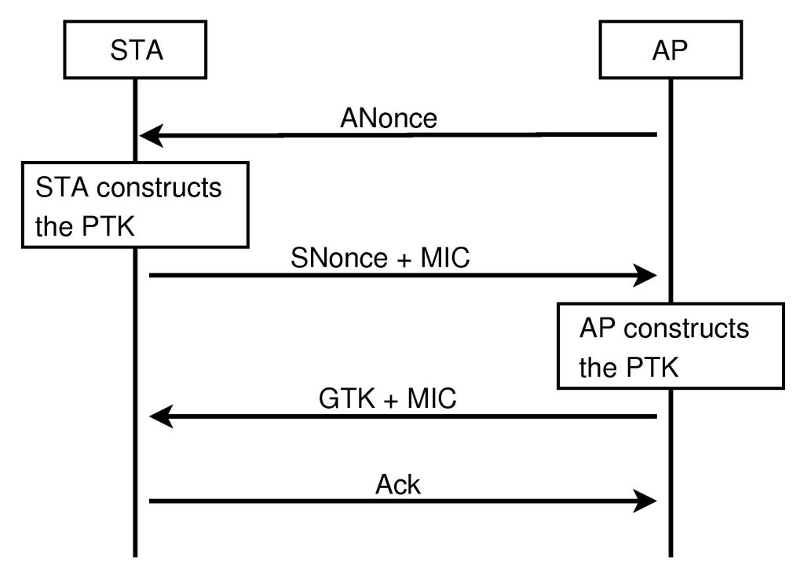
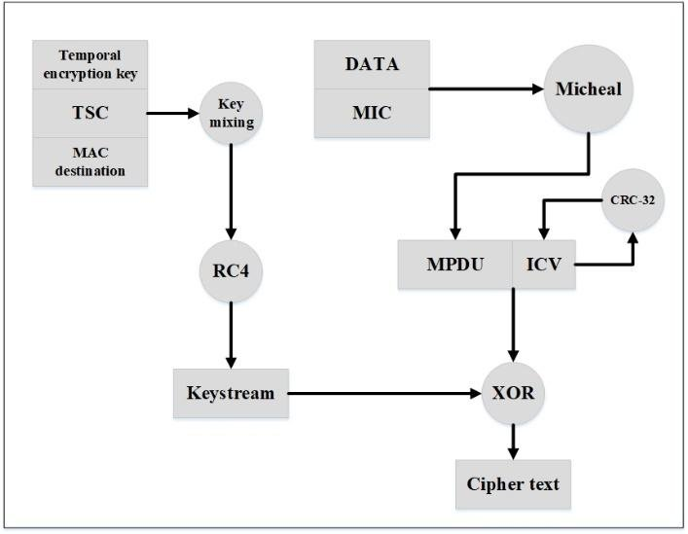
WPA Diagram
WPA2 Diagram
Notes:
ثلاث مخططات للثلاث انواع
WPA1-WPA2-WPA3

Slide 8
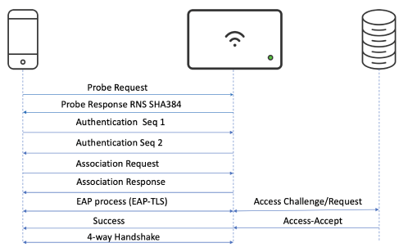
WPA3 Diagram
Notes:
ثلاث مخططات للثلاث انواع
WPA1-WPA2-WPA3

Slide 9
What is WPA
Wi-Fi Protected Access (WPA): designed to replace the WEP protocol. developed by the Wi-Fi Alliance in 2003, uses (RC4) algorithm and Temporal Key Integrity Protocol (TKIP) for encryption. The WPA key is a 256-bit key.
We moved from WPA1 → WPA2 → WPA3 to improve security, encryption strength, and resistance to cyber attacks. Each new version addressed weakness found in the previous one.
Notes:
Temporal Key Integrity Protocol (TKIP) كل سشن يولد مفتاح جديد

Slide 10
Why Did We Move from WPA1 to WPA2?
-WPA1 used TKIP, which was an improvement over WEP. But the TKIP is weak to Michael attack, allowed limited decryption of data.
-Improvement: WPA2 replaced TKIP with AES (Advanced Encryption Standard).
Why Did We Move from WPA2 to WPA3?
-WPA2 weak to Brute-Force Attack (BFA) and the WPA2-PSK (Pre-Shared Key) was susceptible to dictionary attacks, WPA2 had a flaw that allowed attackers to decrypt Wi-Fi traffic through a Key Reinstallation Attack (KRACK).
-WPA3 Replaced PSK with SAE (Simultaneous Authentication of Equals), making password-based authentication more secure. Protects past data even if a hacker obtains the password. WPA3 Enterprise stronger encryption for businesses.
Notes:
AES more secure and used by governments for encryption.
BFA Brute-Force try and error till finding the password.
dictionary attacks hackers try different passwords until they find the correct one.

Slide 11
What is WPA3
Latest Wi-Fi security protocol, enhanced Public Wi-Fi Security OWE(Opportunistic Wireless Encryption), easier Device Setup (Wi-Fi Easy Connect), simplifies connecting loT devices using QR codes and stronger encryption if a password is compromised.
Types of WPA3:
-Personal: 128-bit encryption Uses SAE for stronger password security in home networks.
-Enterprise: 192-bit encryption for businesses and government agencies.
Notes:
simplifies connecting loT devices: (like smart home gadgets)
using QR codes: instead of typing passwords
password is compromised:, old data remains protected prevents attackers from decrypting previously captured data.

Slide 12
Thanks to Tosha

